Slide 1
Analyzing a CNN LSTM Video Description Framework
Project Members:
Nirav Jain
Rohit Naik
Udit Deshmukh
Ruth Okoilu
CSC 591: Spatial Temporal Data Mining
Guides - Dr. Raju Vatsavai and Bharathkumar Ramachandra

Slide 2
Motivation
300 hours of video uploaded to Youtube every minute [2]
Improving indexing and search quality
Content Analysis
Creating personalized systems
Descriptions important for creating narrations for the visually impaired
Notes:
-> Video data is one of the most widely available formats of spatio temporal data.
-> There exist certain spatial properties within a given video frame and also a temporal relation in a sequence of frames.
-> This makes the analysis of video data very interesting.
-> Video data has a high storage requirement and it would be convenient to have a concise representation
-> Huge amount of video data is available. Poorly tagged videos reduce search quality. Humans can make errors while tagging.
-> Analyzing text is computationally less expensive than videos.
-> By analyzing the text, the videos can be put into different silos based on their content.
-> Better recommendations can be provided to users (eg Netflix recommendations).
-> Enables blind people to understand video data.

Slide 3
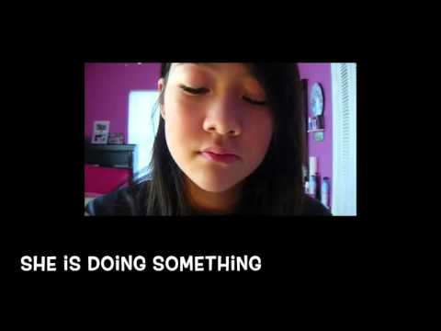
Introduction - Base system
Notes:
Motivation to do the project

Slide 4
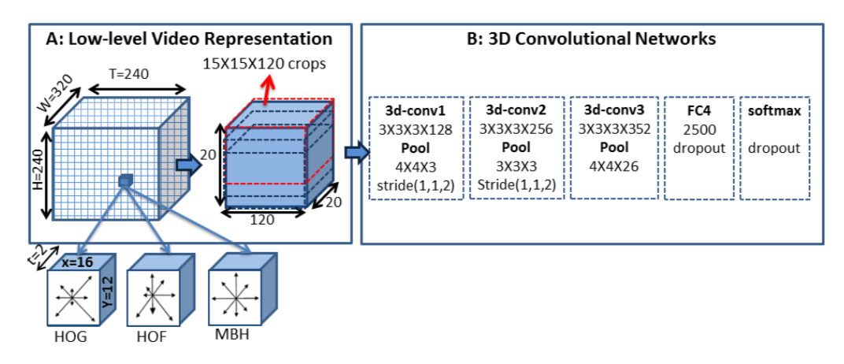
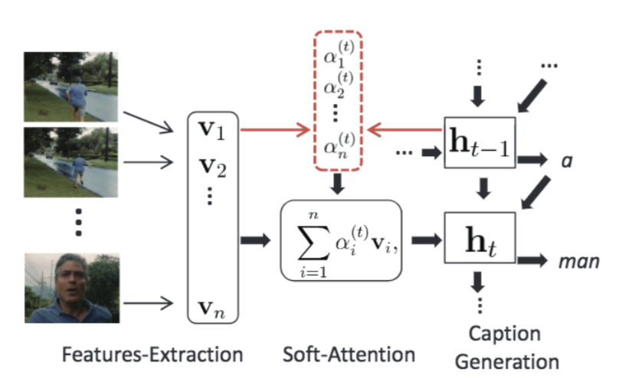
Understanding the current system
Notes:
-> An encoder-decoder architecture
-> Encoder is a 3D- CNN and decoder is an LSTM
-> 3D CNN used to build a higher level representation of the video, that also preserves local structure. This is done by dividing the video into 16 X 12 X 2 cuboids. Each cuboid represented by concatenating histograms of oriented gradients, oriented flow and motion boundaries.
-> 3D CNN consists of three 3D CNN layers followed by ReLU activation and local max pooling.
-> The output of the last CNN layer is concatenated with appearance features extracted by GoogleNet for similar frames.
-> In order to incorporate the global temporal structure, the decoder uses attention mechanism to selectively look at the encoder output. This approach thus has potential of focusing on key elements of the video that may even have short duration.
-> LSTM is a type of Recurrent Neural Network. They avoid the problem of long term dependency. Hence gathers a long term context, rather than short term context

Slide 5
Hyper-Parameters
Importance of Hyper-parameters for Deep learning:
Determine the structure of the neural network
Largely determine the performance of the final model
Determine the learning capacity of the model
Notes:
Encoder-decoder frameworks are effective for producing high learning capacity models for video to text translations as long as critical hyper-parameters are identified and provided with appropriate values.
Irrespective of the kind of neural network employed, there are variables known as hyper-parameters that determine the structure of the neural network. These parameters are usually set prior to training and optimizing weights and bias of the network. The values of these variables largely determine the performance of the final model. As such, it is imperative to understand the magnitude at which each hyperparameter affects the network.
Our study seeks to discover the pivotal hyper-parameters and experimental conditions in which this approach works best.

Slide 6
Hyper-Parameters
Definition Of Hyper-parameters
number of layers: number of LTSM layers
lstmencoder: if True, runs bidirectional LSTM
ctx2out: Feed attention weighted ctx into logit
patience: Number of epoch to wait before early stop if no progress
maxlength: maximum length of the description
maxepochs: The maximum number of epoch to run
Notes:
Some hyper-parameters we tuned includes:
hidden layers Init: parameter used to initialize first hidden layer to cell and hidden state as zero
Lstm encoder -
Bidirectional LSTMs train two instead of one LSTMs on the input sequence. The first on the input sequence as-is and the second on a reversed copy of the input sequence. This can provide additional context to the network and result in faster and even fuller learning on the problem.
ctx2out: Asks if you want to activate the current hidden layer with previous weights, true or false
We chose to experiment with the max len and lstmencoder
We wanted to see if the model has a hard time to generate descriptions when the maximum length is reduced.
And lstmencoder, we wanted to compare performance of bidirctional with uni directional

Slide 7
Ideas for exploration
Experiment with different configuration of hyperparameters
Generating intermediate video descriptions
Visualize the CNN layer
Notes:
These are the ideas we had for exploration
First is to experiment with different configurations of hyperparameters, in order to identify important hyperparameters that play a pivotal role in the performance of the network. However, there are around 25 hyperparameters and therefore testing the effect of each of these would take a lot of time. Therefore, in the interest of time and the limited resources available, we decided to play around with just 2 hyperparameters, but do an exhaustive study on the same.
Secondly, we generated intermediate video descriptions to understand how the descriptions change as the model progresses during training.
After each CNN layer, features from video are extracted. We wanted to visualize the output of each layer as an image, so that we get an intuitive understanding of what kind of content in a video gives better description. But the feature vector did not consist of raw values i.e. not RGB. Rather, it was a low level representation of HOG, HOF and MBH -> (Write what each of these means)
Thus, we decided to focus just on the first 2 tasks

Slide 8
Implementation
Data Exploration
Hardware architecture
Hyperparameter configuration
Generating and tracking intermediate descriptions
Notes:
Our implementation consists of the following 4 things, let’s take a look at each of these individually

Slide 9
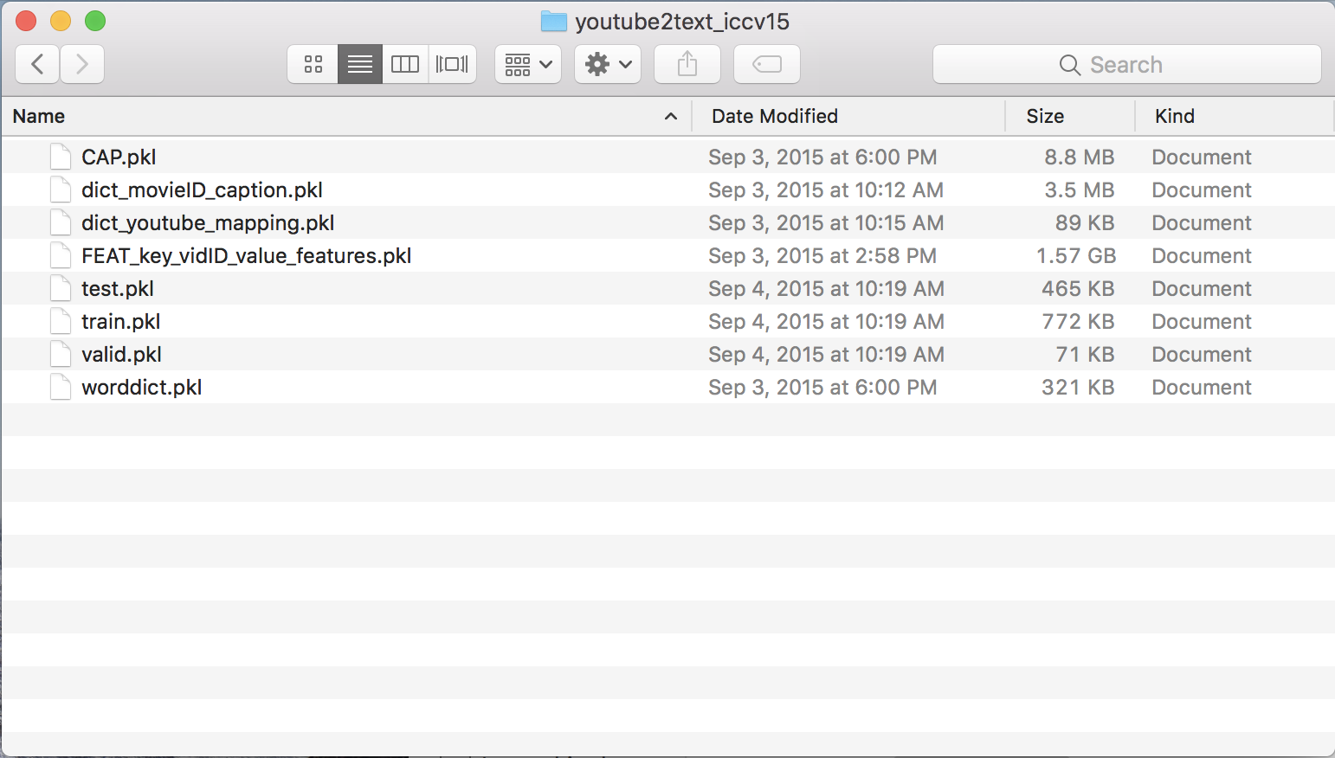
Implementation - Data Exploration
Notes:
The dataset used is Youtube2txt dataset
It’s stored as *.pkl files
In order to understand the data, we wrote a small utility script to deserialize these files and understand the structure of the data. We learned that the videos are present as processed files, i.e. features vectors are extracted for each video.
Each video has varying number of frames in it (depending on the length of the video clip). Each frame is represented as a feature vector. Note that not all frames are represented as feature vectors, rather they select multiple equally spaced frame to capture global structure of the video.

Slide 10
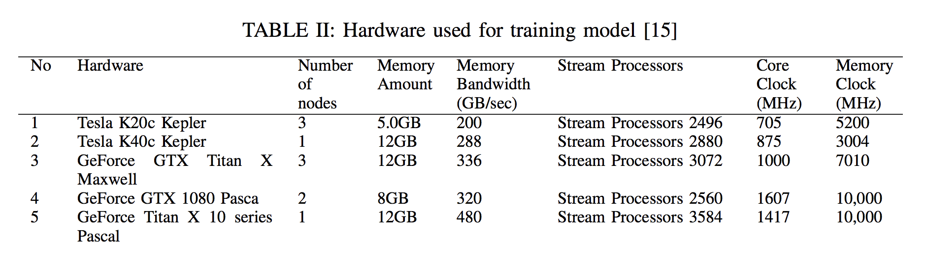
Implementation - Hardware ARChitecture
Google Colab
ARC
Notes:
We include this section because we spent quite some time in deciding an architecture that fits our need. Loading a dataset of 1.7 GB and training a neural network on it is not something that we could do on our local machine.
Google colab is Google’s free cloud service for AI. We explored Google Colab for its free GPU capability.
It creates a workspace on your Google drive account.
We created a script to setup our env on Google colab. Identified and resolved dependencies.
Limitations: 1) GPU is not always available 2) Running bash commands (even simple commands like “rm -rf *” ) were taking a lot of time to execute
The other option for hardware was to use the ARC clusters provided by the university. We used the same script written before to resolve dependencies on ARC.
For people who don’t know what ARC is, it’s a research project that addresses the challenges faced while testing software in a large-scale computing environment
It provides a variety of hardware to use. For our project, we needed a minimum memory of 5 GB as the data itself was around 1.7 GB
So, these are the 5 hardware we used to train our models

Slide 11
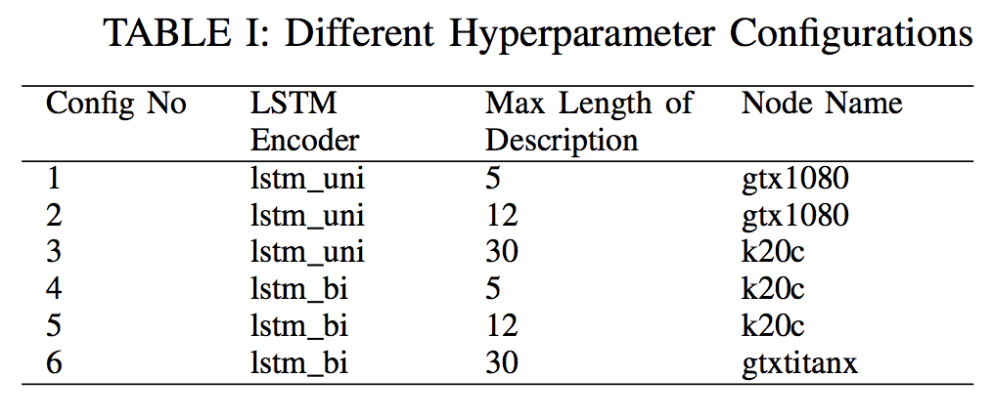
Implementation - Hyperparameter configuration
Notes:
These are the various hyperparmeter configurations that we experimented with.
The first hyperparameter is the lstm encoder, it can be unidirectional or bidirectional.
The difference between the 2 is that unidirectional lstdm encoders only considers the input from past to compute the hidden states. Whereas bidirectional lstms considers inputs from future as well.
For max length of description, we decided to check for values 5,12,30. Primary reason was to check whether a small value provides concise descriptions or not. Also, whether the model has a hard time to generate descriptions when the maximum length is reduced.
Note that config 1 and 4 have max length set to 5. Also, config 5 uses lstm bi rather than uni
Thus, we have 6 unique configurations, with following values set before the learning begins.
And following are the nodes where we ran each of these configurations. These nodes correspond to the hardware we saw before.

Slide 12
Challenges faced
Environment setup and architecture to use for GPU
Running batch jobs on ARC (24 hour limit on each job)
Understanding LSTMs
Notes:
This took quite some time, as we first explored Google Colab since it was free. Due to its limitation we then decided to use ARC clusters. Thus, it took some time to get ARC cluster access and then setup environment on it.
Since LSTM was mentioned as a future scope for the base system, it was important to understand how LSTMs work. Once we understood how LSTMs work, it was easy to realize that a bidirectional lstm would work better in this case.
Once we had the env setup in ARC, we needed a way to run the training in background. ARC uses Slurm workload manager for scheduling jobs. Thus, we checked slurm documentation to create 6 batch jobs, corresponding to each of our 6 configuration. Then we submit the batch job to run, which gets queued and executes when the requested resources are available. One limitation here was that we could not run a batch job for more than 24 hours, which is why we ran our models only for 50 epochs.

Slide 13
Results
Visualizing intermediate descriptions - During training, against validation data.
Visualizing evaluation metrics - During testing, against unseen test data.
Notes:
So, after implementation, I would like to speak about the results of our experimentation
One obvious visualization was generating the intermediate descriptions while the model was being trained. Note that this was done on validation data
Another thing which we wanted to see was how the values of metrics for testing the quality of video descriptions, were varying at each epoch. This was done on test data.
Let us go one by one and see what these results look like

Slide 14
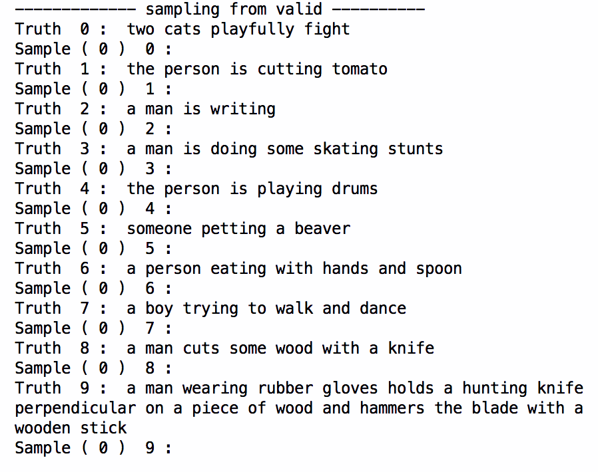
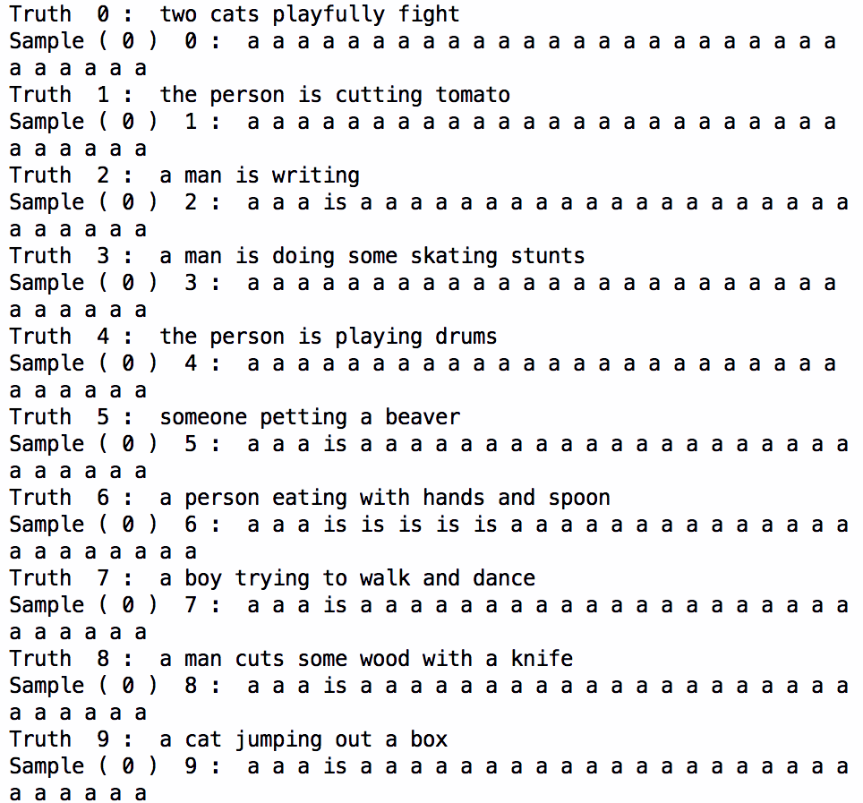
Results - Intermediate Descriptions (Epoch 0)
Config 3
Config 5
Notes:
First, for the intermediate descriptions, we have compared two configurations - one which is the original configuration and the other which stood out from out experiments - over 50 epochs. As you can see, the output of epoch 0 is essentially useless. It does not make much sense. This is obvious considering that the initial weights are randomized.

Slide 15
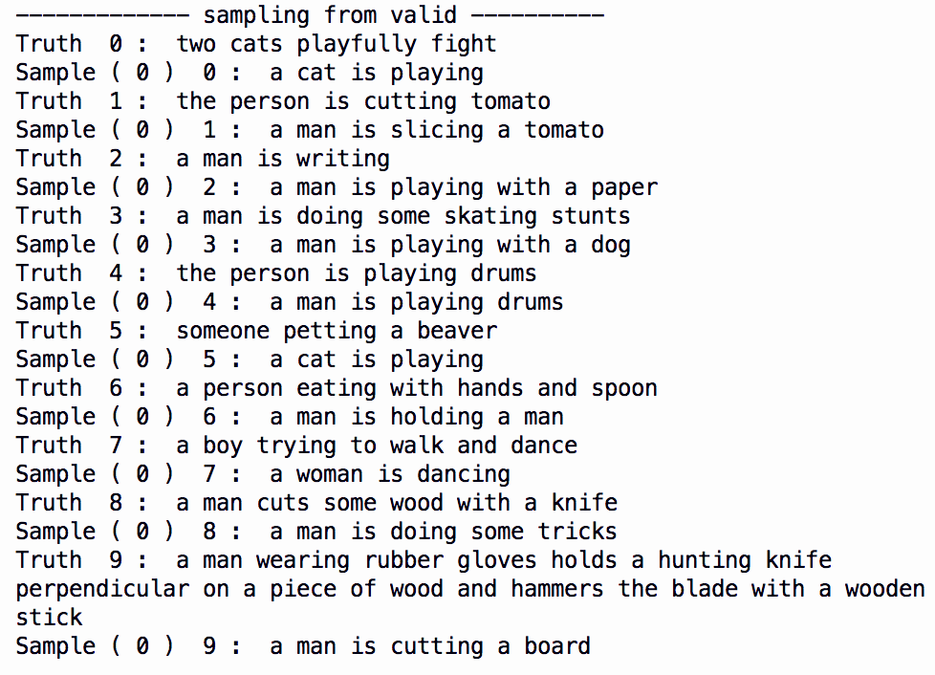
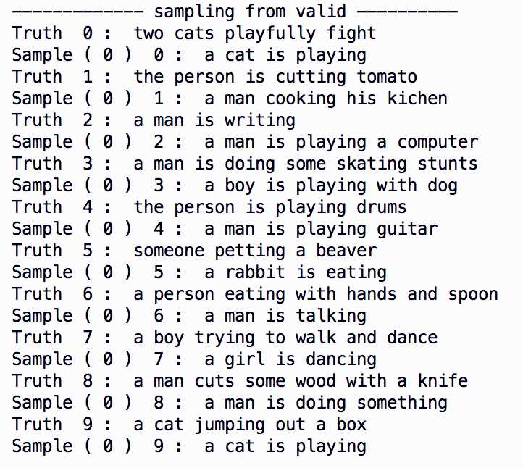
Results - Intermediate Descriptions (Epoch 30)
Config 3
Config 5
Notes:
As we proceed with the epochs, the descriptions start becoming better but not linearly. By this I mean that the quality of video descriptions increases after some epoch, but then remains almost the same for a few succeeding epochs. Thus, it increases in parts.
After 30 epochs, this is what the description looks like. (Show 2-3 examples from the image)

Slide 16
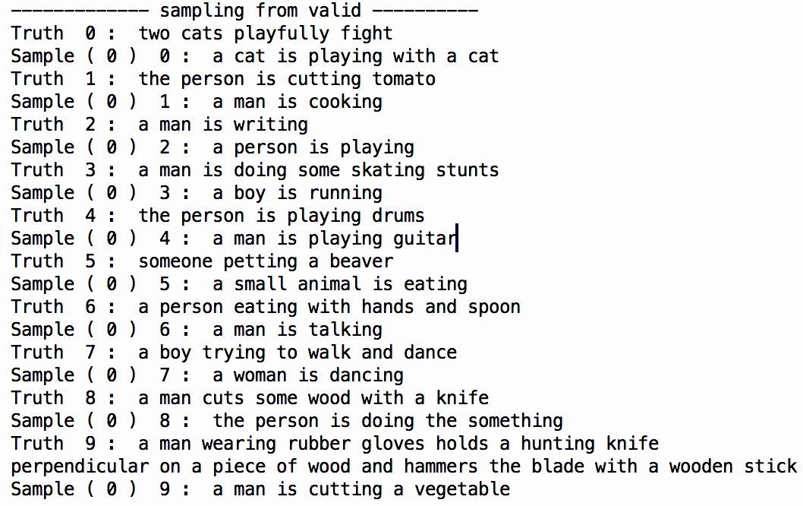
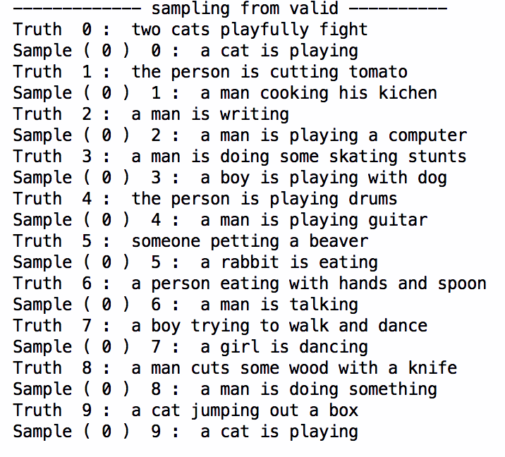
Results - Intermediate Descriptions (Epoch 50)
Config 3
Config 5
Notes:
This was our final epoch and the output generated from it (first examples)
As you can see, config 5 has not yet reached that epoch where the video descriptions improve is still showing results similar to epoch 30. Config 3, on the other hand, shows an improvement in the description generated.
The existing system identifies action and appearance features separately. But, we found out that the model generally identifies the action much more accurately than it identifies the objects involved in those actions. (Last example) - Cutting a board vs cutting a vegetable.

Slide 17
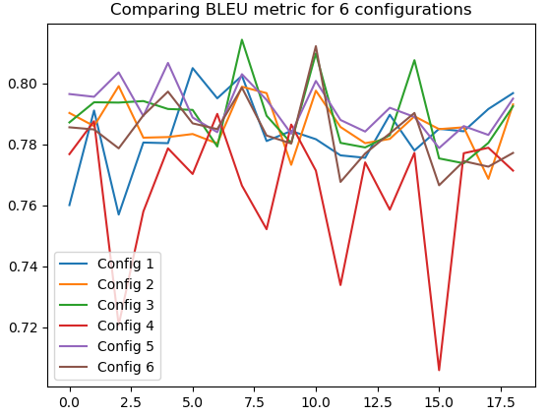
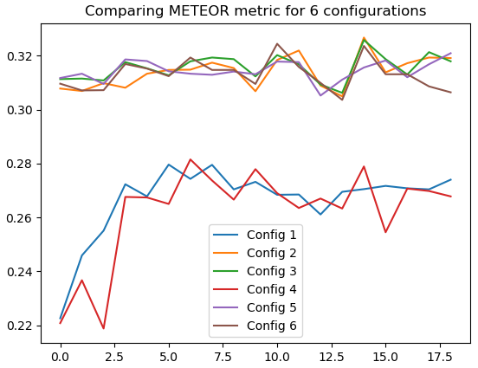
Results - Evaluation metrics
BiLingual Evaluation Understudy Metric for Evaluation of Translation with Explicit ORdering
Notes:
As mentioned earlier, we also plotted the values of the evaluation metrics on the test data.
BLEU (bilingual evaluation understudy) - how similar the candidate text is to the reference texts, with values closer to 1 representing more similar texts. E.g. Candidate(for testing) - ‘the the the the’ and Reference(Truth) - ‘the cat is on the mat’ → P=m/wt where m is number of words from the candidate that are found in the reference, and w_{t} is the total number of words in the candidate. → P = 4/4 = 1. This is a perfect score, despite the fact that the candidate translation is not at all similar to the reference translation. That explains the high BLEU score at the initial epochs because the output that we got initially was something like - ‘a a a a ...’ which was similar to the candidate text we used in our example above.
Relate it to ‘a a a a a …’ and high BLEU but low METEOR score.
METEOR (Metric for Evaluation of Translation with Explicit ORdering) - The metric was designed to fix some of the problems found in the more popular BLEU metric, and also produce good correlation with human judgement at the sentence level.

Slide 18
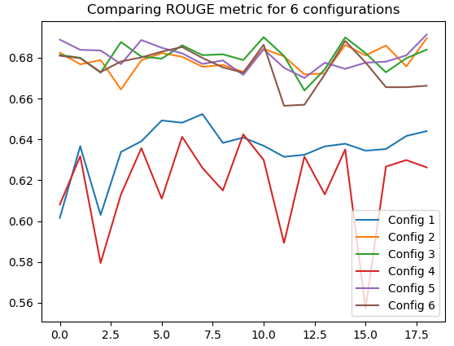
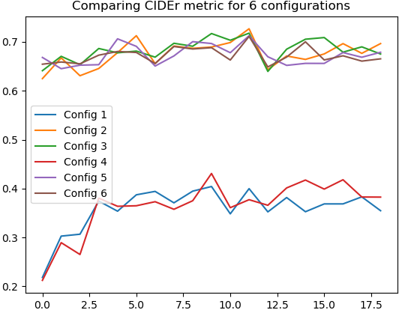
Results - Evaluation metrics (contd...)
Recall-Oriented Understudy for Gisting Evaluation Consensus-based Image Description Evaluation
Notes:
•ROUGE: ROUGE stands for Recall-Oriented Understudy for Gisting Evaluation. It is essentially of a set of metrics for evaluating automatic summarization of texts. It works by comparing an automatically produced summary against a set of reference summaries (typically human-produced).
•CIDEr (Consensus-based Image Description Evaluation) - This protocol enables a comparison of machine generation approaches based on their human-likeness, without having to pay much attention to content, grammar, etc. with respect to each other.
From these figures, we can easily conclude that -
Config 1, 4 are have consistently bad values of all metrics
Config 3 has good performance but the good values are in peaks
Config 5 has consistently high values in these metrics

Slide 19
Conclusion
Config 5 gives consistently good values of metrics on test data which shows that it is a robust model which is able to produce good descriptions for unseen data.
The parameter maxlen has an important role to play in deciding the quality of the model.
Using bidirectional LSTM gives consistent results throughout the epochs.
The intermediate text descriptions generated from the validation data provides a measure to intuitively understand the attention weights updated by the RNN layer.
Notes:
Along with Config 5 - Config 3 gives spikes of good results in the graphs which is actually not an ideal model as its results will highly vary depending on the number of epochs.
Reason for maxlen being important - We can see that Configs 1, 4 are clearly not the ideal configurations for the model. The truth samples selected by the model from the training set have very limited context and also the number of training samples from the data-set with satisfy maxlen = 5 are less. This could have led to under-fitting of the model.
Reason for LSTM - because of its ability to processes information from past to future as well as from future to past, thereby giving a better context as compared to unidirectional LSTM.

Slide 20
Acknowledgements
We would like to thank Dr. Raju and Bharath for their guidance
Arctic-capgen-vid team for providing the base implementation [3]
Dr. Mueller and Neha for providing access to ARC and resolving issues
ARC Users List

Slide 21
References
[1] Yao, Li, et al. "Describing videos by exploiting temporal structure." Proceedings of the IEEE international conference on computer vision. 2015.
[2] https://fortunelords.com/youtube-statistics/
[3] https://github.com/yaoli/arctic-capgen-vid

Slide 22
Links
Repo - https://github.ncsu.edu/rtnaik/video-description-cnn-rnn
Dataset - https://goo.gl/cQDXNK
Setup steps can be found in README file inside the repo

